Slide 1
Module No 2
RPA Delivery Methodology & Learning

Slide 2
Learning Objectives
Process automation lifecycle
Process Discovery Methods/Opportunity Assessment
Life Cycle Sample Delivery Documentation
Various Key Terms Used in RPA Development Methodology
Learning Portals | Communities Walk Through
Hands on Exercise to Determine RPA Complexity …

Slide 3
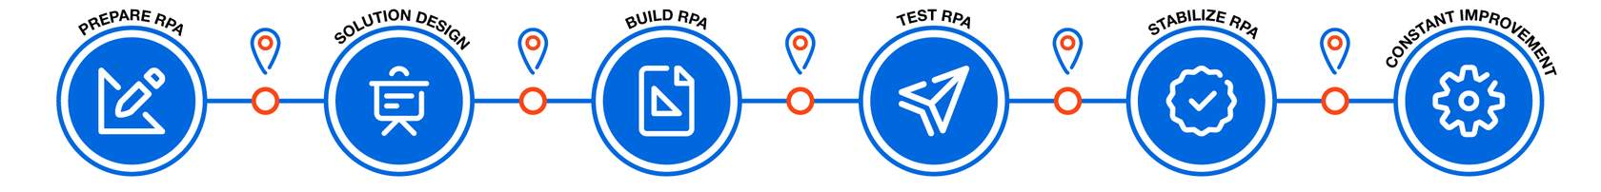
Process Automation Lifecycle(RPA Lifecycle)
Prepare RPA – Calculate and understand the automation complexity of the in-scope processes, Map the automation benefits
Solution Design- Document and validate As-Is process flow and all relevant data for RPA, Design the To-Be process flow [Handover Documents ]
Build RPA- Design Workflow and Update the PDD to include the requested changes.
Test RPA- Test scenarios to cover all the business use-cases, rules and exceptions
Stabilize RPA- User Manual must be updated throughout all the implementation phases
Constant Improvement - Monitor the performance of the process and measure it against the baseline

Slide 4
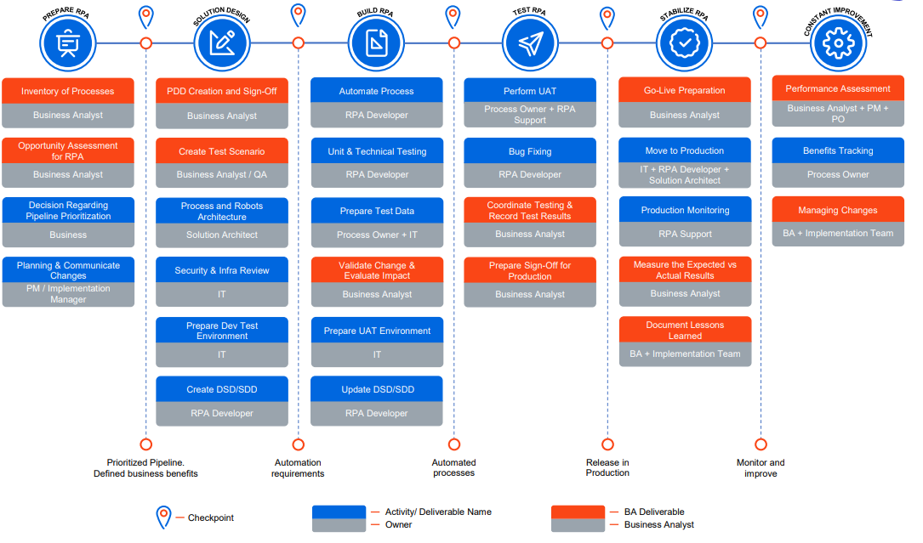
Source: BA Handbook UiPath

Slide 5
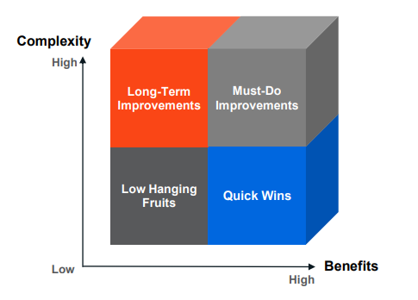
Process Discovery Methods/Opportunity Assessment
What should be automated?
There are a few aspects that have to be taken into consideration for choosing automation candidates. The following processes should be automated:
Repetitive steps
Time-consuming steps
High-risk tasks
Tasks with a low-quality yield
Tasks involving multiple people and multiple steps
And everything else!
What can be automated?
In order to automate something, it needs to have the following characteristics:
Well defined and rule-based steps
Logical
An input to the task can be diverted to the software system
Input can be deciphered by software systems with available techniques
The output system is accessible
Benefits are more than the cost

Slide 6
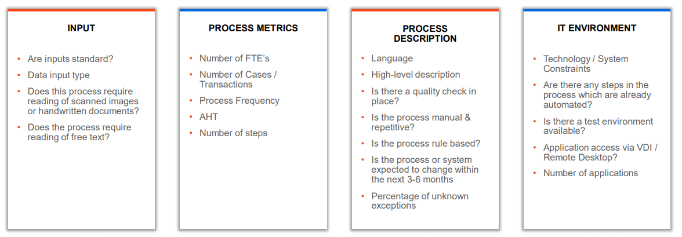
Opportunity Assessment

Slide 7
Automation Complexity
A LOW complexity automation project is, in general, one that can be easily created with the recorder and requires small customizations thereafter.
Development time: 1-2 weeks
A MEDIUM complexity automation project could be one that requires the transfer of data between applications
Development time: 3-4 weeks
A HIGH complexity project is one that requires programming skills (.NET) in terms of string manipulation functions, working with arrays, data tables, collections, data formatting, exception handling, terminal emulators
Development time: 4-6 weeks
Factors Driving Automation Potential
Rule Based ?
Process Types ?
Standard Input ?
Unknown Exception ?
Business Benefits
Cost savings
Productivity Gain
Business Agility
Quality improvements / Error reduction
Compliance
Customer Satisfaction

Slide 8
Quick Demo of Template
Trainer Will Demo Assessment Template.

Slide 9
Process Documentation Method
Stages of Process Documentation
Prepare a high-level process map with process description
Validate the high-level process map with the Process Owner
Update the document by including more scenarios and business rules and validate it with the Process Owner
Prepare the detailed Level 4 process map (including all scenarios) for the As-Is process
Define the To-Be Level 4 process map together with the solution description and validate these with the Process Owner
Prepare the PDD and include any support material that would detail the business rules, roles matrix, the input & output etc.
Validate the PDD with the Process Owner and update the PDD with all the received feedback; if needed, organize sessions
for clarifications
Obtain Sign-Off
Methods and Tools
Key Stroke Document - Process activities detailed at key stroke level with respective screen shots captured, UiPath Task Capture is Used to Record Keystroke.
Process Video Recordings - Video recordings of process activities, Capture every action performed by the SME on the application layer
Business Logic Translation Table- Either use the existing business rules table or document the business rules in a separate file

Slide 10
Demo of PDD
Trainer Will Demo PDD Template.

Slide 11
RPA Lifecycle Documents Sample
PDD – What is being automated
SDD or DSD- How to be automated
Test Scenarios- How to be tested
Release Notes – How to be deployed
Operation Handover Guide- How to be supported

Slide 12
PDD – Table of Contents
Introduction
1.1 Purpose of the Document
1.2 Objectives
1.3 Key Contacts
1.4 Minimum Prerequisites for Automation
2. As-Is Process Description
2.1 Process Overview
2.2 Applications Used in the Process
2.3 As-Is Process Map
2.4 Detailed As-Is Process Steps
2.5 Input Data Description
3. To-Be Process Description
3.1 To-Be Detailed Process Map
3.2 Parallel Initiatives / Overlap (if applicable)
3.3 In Scope for RPA
3.4 Out of Scope for RPA
3.5 Business Exceptions Handling
3.6 Application Error and Exception Handling
3.7 Reporting
4. Other Observations
5. Additional Sources of Process Documentation
A process documentation that describes only “the happy path” is considered incomplete, so it is important to keep track of both
business exceptions and technical exceptions.
Make sure you cover all possible scenarios when something might not go as planned

Slide 13
Various Key Terms Used in RPA Development Methodlogy
As-is-map
To-be-map
Unattended vs Attended
Hyperautomation
Hypercare
AHT
FTE Savings
L4 Map
Click-Trail
OCR Engine
Queues

